Slide 1
Supplements, Storage, and Substitutes
Section 4

Slide 2
Objectives
Recommend safe milk storage options.
Review indications for formula use and available options.
Recommend appropriate breastfeeding management as recommended by the American Academy of Pediatrics

Slide 3
Supplementation
ABM Clinical Protocol #3: Supplementary Feedings in the Healthy Term Breastfed Neonate, Revised 2017
https://www.bfmed.org/assets/DOCUMENTS/PROTOCOLS/3-supplementation-protocol-english.pdf

Slide 4
Indications for Supplemental Feedings
Separation
Maternal illness resulting in separation of infant and mother (e.g., shock or psychosis)
Mother not at the same hospital
Infant with inborn error of metabolism (e.g., galactosemia)
Infant who is unable to feed at the breast (e.g., congenital malformation, illness)
Maternal medications (those contraindicated in breastfeeding)
Notes:
MSUD and PKU are also IEMs with contraindications for exclusive breastfeeding
Maternal meds:
Antineoplastic agents, Immunosuppressants, Lithium, Chloramphenicol, Ergot alkaloids, Radiopharmaceuticals,
Bromocriptine, Iodides

Slide 5
Why is Supplementation Discouraged?
Can prevent the establishment of maternal milk supply
Has adverse effects on breastfeeding (e.g., delayed lactogenesis, maternal engorgement)
Alters infant bowel flora
Sensitizes the infant to allergens (depending on the content of the feeding and method used)
Interferes with maternal infant bonding
Blomquist HK, Jonsbo F, Serenius F, Persson LA: Supplementary feeding in the maternity ward shortens the duration of breast feeding. Acta Paediatrica 83:1122–1126, 1994

Slide 6
Supplementation?
Common situations in which evaluation and breastfeeding management may be necessary but supplementation
is NOT indicated:
The sleepy infant with fewer than 8 to 12 feedings in the first 24 to 48 hours with < 7% weight loss and no signs of illness.
Newborns are normally sleepy after an initial 2-hour alert period after birth. They then have variable sleep–wake cycles, with an additional one or two wakeful periods in the next 10 hours whether fed or not. Careful attention to an infant’s early feeding cues and gently rousing the infant to attempt breastfeeding every 2–3 hours is more appropriate than automatic supplement after 6, 8, 12, or even 24 hours.
The general rule in the first week is: “an awake baby is a hungry baby!”
Increased skin-to-skin time can encourage more frequent feeding.

Slide 7
Supplementation?
The infant with bilirubin levels < 20 mg/dL after 72 hours of age, when the baby is feeding well and stooling adequately with weight loss <7%
The infant who is fussy at night or constantly feeding for several hours
The sleeping mother
During emergencies and stressful situations, breastfeeding should continue.
During growth spurts
Notes:
no

Slide 8
Consider Supplemental Feedings (Infant Indications)
Asymptomatic Hypoglycemia
Documented by laboratory blood glucose measurement (not bedside screening methods)
Unresponsive to appropriate frequent breastfeeding
Symptomatic infants should be treated with intravenous glucose
Significant Dehydration
10% weight loss, high sodium, poor feeding, lethargy, etc.
Not improved after skilled assessment and proper management of breastfeeding
Weight loss of 8–10% accompanied by delayed lactogenesis II (day 5 [120 hours] or later)

Slide 9
Consider Supplemental Feedings (Infant Indications, continued)
Delayed bowel movements or continued meconium stools on day 5 (120 hours)
Insufficient intake despite an adequate milk supply (poor milk transfer)
Low Birth Weight
When sufficient milk is unavailable
When macronutrient supplementation is indicated
Hyperbilirubinemia
Neonatal jaundice associated with starvation where breastmilk intake is poor despite appropriate intervention
Breastmilk jaundice when levels reach 20–25 mg/dL (mol/L) in an otherwise thriving infant and where a diagnostic and/or therapeutic interruption of breastfeeding may be helpful but not necessary
No clear reason to intervene if baby thriving

Slide 10
Consider Supplemental Feedings (Maternal Indications)
Primary glandular insufficiency (primary lactation failure), as evidenced by poor breast growth during pregnancy and minimal indications of lactogenesis
Occurs in <5% of women
Delayed lactogenesis II (after day 3–5) and inadequate intake by the infant
Retained placenta (lactogenesis probably will occur after placental fragments are removed)
Sheehan’s syndrome (postpartum hemorrhage followed by absence of lactogenesis)
Breast pathology or prior breast surgery resulting in poor milk production
Intolerable pain during feedings unrelieved by interventions
Unavailability of mother due to severe illness or geographic separation
Notes:
Breast pathology that may interfere with breastfeeding
Tubular breasts, Reduction mammoplasty, Augmentation mammoplasty, Lumpectomy, Previous treatment for breast cancer, Trauma and burns, Pierced nipples
Sheehan’s Syndrome is hypopituitaryism caused by infarction of the blood supply to the pituitary secondary to severe postpartum hemorrhage.
• Retained placenta results in continued high levels of progesterone, which inhibits milk production.

Slide 11
Which Supplemental Feed?
Expressed human milk is the first choice
But sufficient colostrum in the first few days (0–72 hours) may not be available
Hand expression may elicit larger volumes than a pump in the first few days and may increase overall milk supply
Breast massage along with expressing with a mechanical pump may also increase available milk
Pasteurized donor human milk is second choice
Protein hydrolysate formulas may be next choice
Preferable to standard artificial milks as they avoid exposure to cow’s milk proteins
Reduce bilirubin levels more rapidly
May convey the psychological message that the supplement is a temporary therapy, not a permanent inclusion of artificial feedings
Supplementation with glucose water is not appropriate

Slide 12
How Much?
Breast milk transfer (example 3.5kg newborn)
Day 1: 6ml/kg/24h (21ml per day)
Day 2: 25ml/kg/24h (87.5ml per day)
Day 3: 66ml/kg/24h (231ml per day)
Day 4: 106ml/kg/24h (371ml per day)
Infants fed artificial milks commonly (but unnecessarily) have higher intakes than breastfed infants
Newborn stomach capacity
5ml/kg for an average of 20ml
Notes:
7-123 ml/day first day
Average 45ml first day

Slide 13
Recommended Volumes
Day of Life |  | Volume per feed
Day 1 |  | 2-10ml
Day 2 |  | 5-15ml
Day 3 |  | 15-30ml
Day 4 |  | 30-60ml
Notes:
Breast or bottle feeds

Slide 14
Milk Storage
Human milk is a fresh, living food with antioxidant, antibacterial, prebiotic, probiotic, and immune-boosting properties along with nutrients.
Some nutrients and health properties change with storage, but milk may be safely stored with maintenance of its unique qualities.
ABM Clinical Protocol #8: Human Milk Storage Information for Home Use for Full-Term Infants, Revised 2017
https://abm.memberclicks.net/assets/DOCUMENTS/PROTOCOLS/8-human-milk-storage-protocol-english.pdf

Slide 15
Stored Human Milk
Smell and taste may be different
Due to lipase activity
Breaks fat into fatty acids
Aids the infant in milk digestion, especially preterm infants
Is not harmful
This lipolysis has antimicrobial effects preventing growth of microorganisms in thawed refrigerated milk
Do not reheat above 40°C (104°F)
Results in loss of enzyme activity

Slide 16
Human Milk Storage
Recommendations based on bacterial growth
Room temperature (10°-29°C, 50°-85°F)
3-4 hours for warmer rooms (80°-89°F)
6-8 hours for cooler rooms (77°)
But refrigerate as soon as possible if not going to be used within that time
Small cooler (15°C, 59°F)
24 hours based on minimal bacterial growth in a study by Hamosh
Notes:
Warmer rooms 27-32C

Slide 17
Human Milk Storage
Refrigerator (4°C, 40°F)
Recommendations based on bacterial growth
Low growth after 4-8 days
Recommendations based on bactericidal capacity
Significant loss by 48-72 hours
Notes:
Bacterial growth is in milk with low levels of contamination at time of expression

Slide 18
Human Milk Storage
Freezer (-4° to -20°C)
Safe for at least 3 months
Changes after 90 days in freezer (based on small studies)
Decreased fat, protein, calories, lactoferrin levels and bioactivity
Increased acidity
Likely preserved (but paucity of research)
Vitamins A ,E, and B, enzymes, lactose, zinc, immunoglobulins, lysozyme
Significant decrease
Vitamin C
No bacterial growth for at least 6 weeks
Foods frozen at -18°C (0°F) are indefinitely safe from bacterial contamination
Preserved bactericidal capacity for at least 3 weeks
Store in back of freezer in a well sealed container
Notes:
Back of freezer to avoid intermittent rewarming from freezer door opening
Well sealed container to avoid contamination

Slide 19
Milk Storage Guidelines
Storage Location | Temperature | Maximum recommended storage duration
Room temperature | 16°-29°C 60°-85°F | 3-4 hours optimal 6-8 hours under very clean conditions
Refrigerator | ≤4°C 39F | 72 hours optimal 5-8 days with very clean conditions
Freezer | <-4°C 24°F | 6 months optimal 12 months acceptable

Slide 20
Use of Stored Milk
Use freshest milk first
Fresh milk is of higher quality than frozen milk
Contains current maternal sIgA relevant to recent exposures
Highest in antioxidants, vitamins, protein, fat, and probiotic bacteria
Milk may be drunk cool, at room temperature, or warmed based on infant preference
To defrost
Thaw in refrigerator overnight
Results in less fat loss than thawing in warm water
Run under warm water or set in a container of warm water
Do not microwave
Decreases bacteria count BUT
Heats milk unevenly and
Decreases anti-infective qualities of milk

Slide 21
Use of Stored Milk
Thawed milk
Loses ability to prevent bacterial growth within 24 hours of thawing
Previously frozen milk should not be at room temperature for more than a few hours after being thawed for 24 hours
Little information on refreezing thawed milk
No recommendation can be made

Slide 22
Use of Stored Milk
Remaining milk after partial feed
Bacterial contamination of milk from baby’s mouth occurs
Recommendations are to discard milk 1-2 hours after the feed
Previously frozen human milk that has been thawed for 24 hours should not be left out at room temperature for more than 2 hours

Slide 23
Human Milk Storage
Universal precautions are not required for handling of human milk
Can be stored in workplace refrigerator where food is stored
Can be stored in personal freezer pack

Slide 24
Human Milk and Bacteria
Normally contains nonpathogenic bacteria
Important in establishing the neonatal intestinal flora
Are probiotics that create intestinal conditions unfavorable to pathogenic organisms
No need to discard milk from a mother with breast or nipple pain due to bacterial or yeast infection
Discard milk that is stringy, foul, or purulent

Slide 25
Shelf life
Human milk
Meant to be consumed at time of production
Formula
Must have a shelf life of at least one year

Slide 26
Human Milk Substitutes
Three forms
Ready to feed
No additional preparation needed
Sterile
Concentrated liquid
Must add equal amount of water
Generally come in 13oz can which is diluted to 26oz formula
Sterile
Powder
Add 1 scoop of powder to 2oz of water
12.9oz can will make ~95oz formula
25.7oz can will make ~189oz formula
Not sterile

Slide 27
Indications for Soy Formula
Galactosemia
Vegetarian parents who want infant to have vegetarian diet
Hereditary lactase deficiency (very rare)
Do not use in cow milk protein allergy
~15% will also be allergic to soy
Do not use in milk protein-induced enteropathy or enterocolitis
Can be also be sensitive to soy proteins
No value for treating colic or fussiness
Does not prevent development of atopic diseases

Slide 28
Protein Hydrolysate Formulas
Partially hydrolyzed and extensively hydrolyzed formulas may NOT be used interchangeably in infants with milk protein allergy.

Slide 29
Protein Hydrolysate Formulas
Partially Hydrolyzed Protein Formulas
Enfamil Gentlease
Nestle Good Start
Nestle Good Start Soy
Marketed as easier to digest
No real indication for these
Not beneficial for cow milk protein enteropathy

Slide 30
Protein Hydrolysate Formulas
Extensively Hydrolyzed Protein Formulas
Protein-based
Pregestimil Nutramigen Alimentum
Amino Acid-based
Elecare Neocate
Useful for infants who cannot digest or are severely intolerant to intact cow milk proteins
MPA/cow milk protein enteropathy or enterocolitis
Useful in infants with significant malabsorption due to GI or hepatobiliary disease
CF, short gut syndrome, biliary atresia, cholestasis, and protracted diarrhea

Slide 31
Ingredients | Human Milk | Cow Milk | Cow Milk Protein-Based Formula | Soy Protein-Based Formula | Protein Hydrolysate Formula
Carbohydrate (g/dL) | Lactose 7.0 | Lactose 4.8 | Lactose Corn Syrup 3.6 to 3.7 | Sucrose Corn Syrup 3.6 | Sucrose Corn Syrup 3.4 to 3.7
Protein (g/dL) | Human milk protein whey: casein ratio of 75:25 Total: 1.1 | Cow milk protein, whey: casein ratio of 22:78 Total: 3.3 | Nonfat milk Demineralized whey 1.4 | Soy isolate Methionine 1.8 to 2.0 | Cow milk protein hydrolyzed to reduce allergenicity 1.9
Fat (g/dL) | Human milk fat contains more absorbable triglyceride (3.8) | Butterfat contains more volatile fatty acids (3.7) | Soy oil Coconut oil Palm Oil 3.6 to 3.7 | Palm Olein Soy oil Coconut Oil 3.6 to 3.7 | Medium-chain triclyceride oil Soy oil Coconut Oil 3.4 to 3.7
Calcium (mg/L) | 280 | 1,226 | 530 | 710- higher calcium content due to inhibition of adsorption by phytates | 640 to 710
Phosphorus (mg/L) | 147 | 956 | 284 to 360 | 507 to 560 | 12
Iron (mg/L) | Vitamin C and lactose facilitate absorption (0.4) | 0.5 | 5.0 | 12 | 12
Suggested Uses | Preferred for all infants | Children older than 1 year of age who have normal gastrointestinal tract | Infants who have normal gastrointestinal track but cannot be breastfed | Infants who have cow milk allergy (30% may have cross-reactivity), lactose malabsorption, galactosemia | Infants who have good allergies or underlying gastrointestinal damage
Notes:
This table shows the differences in composition between human milk, cow milk, and infant formulas. It is from Peds in Review Nov 2006

Slide 32
Growth Differences between Breastfed and Formula fed Infants
Breastfed infants gain more weight than formula fed infants during the first 3-4 months then slow down during the latter half of the first year
The breastfed infants are healthy but become leaner
Notes:
Because of this normal growth pattern they are all too often are judged as faltering in their growth The pediatric growth charts more recently released by the United States Center for Disease Control (CDC) are an improvement but represent an average growth pattern of breast-fed and formula-fed infants, both sick and well.

Slide 33
WHO International Code of Marketing of Breastmilk Substitutes

Slide 34
The Code
The Code aims to contribute to the provision of safe and adequate nutrition for infants, by the protection and promotion of breastfeeding, and by ensuring the proper use of breast-milk substitutes, when these are necessary, on the basis of adequate information and through appropriate marketing and distribution
If substitutes are needed, they should be available when needed but not promoted
Does NOT ban formula

Slide 35
Products Covered by The Code
Breast-milk substitutes, including infant formula
Include any milks (or milk substitutes) that are specifically marketed for feeding infants and young children up to the age of 3 years
Includes follow-up formula and growing-up milks
Includes other foods and beverages promoted to be suitable for feeding a baby during the first six months of life when exclusive breastfeeding is recommended
Also would include baby teas, juices and waters, feeding bottles, and teats
Has not been completely updated, but it has been revised every two years by the WHA to remain current and relevant as an international guiding document

Slide 36
The Code
Ensures proper use of Breastmilk Substitutes (BMS)-medically necessary; requested after informed consent documented.
Prohibits marketing of BMS, complementary foods, bottles and teats
Educational materials free of BMS marketing and no group education on preparation of formula
Education on BMS includes hazards of preparation that are eliminated by breastfeeding

Slide 37
Ten Major Provisions of The Code
No advertising or promotion of breastmilk substitutes and products within the scope of the code and relevant WHA resolutions to the general public
Means no special displays, discount coupons, or special sales
No free samples or gifts to mothers or healthcare workers
Information and labels must advocate breastfeeding and warn against bottle feeding and contain no pictures or text that idealizes the use of breastmilk substitutes
The health care system must not be used to promote the use of breastmilk substitutes
No free or low cost supplies of breastmilk substitutes

Slide 38
Ten Major Provisions
Health professionals allowed to receive samples only for research purposes
Information to health workers must be scientific and factual
No contact between marketing personnel and mothers
No gifts or personal samples to healthcare workers
All information on artificial feeding, including labels, should explain the benefits of breastfeeding, the costs and hazards associated with artificial feeding and the correct use of breastmilk substitutes

Slide 39
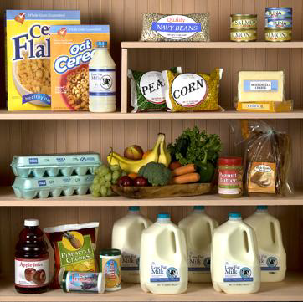
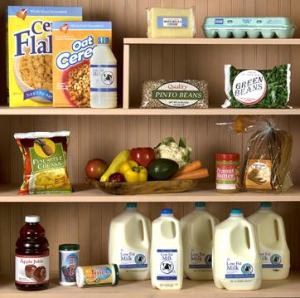
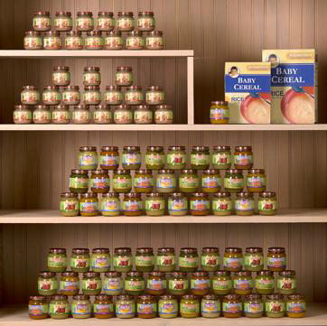
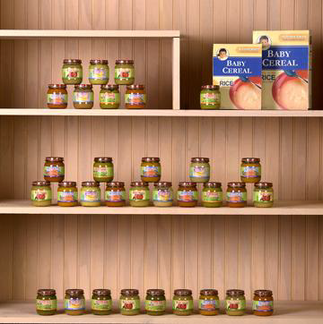
WIC Packages
Exclusive BF Package
Mostly BF Package
No Breastfeeding

Slide 40
AAP Policy Statement
Recommended Breastfeeding Practices
Do not give water, juice, or solids in the first 6 months.*
Initiate iron supplements only if indicated clinically in the first 6 months.
Include iron-rich foods after 6 months of age.
Supplement with vitamin D daily, beginning during the first 2 months.
Provide fluoride after 6 months if household water supply is deficient.
Avoid cow’s milk before 12 months.
*There is a difference of opinion among AAP experts on this matter. The Section on Breastfeeding acknowledges that the Committee on Nutrition supports introduction of complementary foods between 4 and 6 months of age where safe and nutritious complementary foods are available.
Copyright © 2003, Rev 2005 American Academy of Pediatrics
Notes:
Water, juice, formula, and solids are not necessary in the first 6 months for breastfed infants.
All breastfed infants and children should receive 200 IU of vitamin D daily, beginning during the first 2 months of life. Human milk does not contain sufficient vitamin D to prevent rickets. (Gartner LM, Greer FR, and the American Academy of Pediatrics Section on Breastfeeding and Committee on Nutrition. Prevention of rickets and vitamin D deficiency: new guidelines for vitamin D intake. Pediatrics. 2003;111: 908–910) Adequate sun exposure is the usual way vitamin D is produced in the skin. Pediatricians and dermatologists are concerned about the long-term effects of sunlight exposure on children’s skin and recommend limited sunlight exposure. Furthermore, sunscreens prevent vitamin D production in the skin.
Most infants require a supplemental source of iron by about 6 months of life. This can be provided by iron supplements or by adding iron-rich foods or iron-fortified foods, such as infant cereal, to the diet. Also, by 6 months, the family water supply should be evaluated to make sure that adequate fluoride is present to prevent dental caries.
The American Academy of Pediatrics does not recommend introduction of whole cow’s milk prior to the first birthday. Mothers who are not breastfeeding exclusively or who choose to wean their infants from the breast prior to the first birthday should feed iron-fortified infant formula.

Slide 41
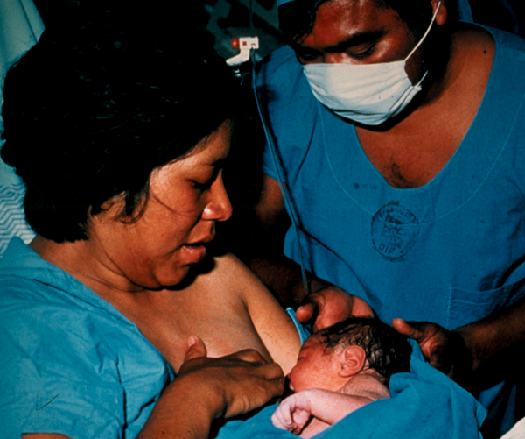
AAP Policy Statement
Role of Pediatricians and Other Health Care Professionals in Protecting, Promoting, and Supporting Breastfeeding
Promote hospital policies
that facilitate breastfeeding
Eliminate mother-infant separation
Eliminate formula discharge packs
Photo © La Leche League International
Copyright © 2003, Rev 2005 American Academy of Pediatrics
Notes:
Continuous rooming-in from the time of delivery until hospital discharge encourages optimal breastfeeding.
Infant formula should not be offered to breastfed infants in the hospital, unless there is a clear medical indication, nor should breastfeeding mothers be given infant formula or formula coupons to take home from the hospital.

Slide 42
AAP Recommendations on Breastfeeding Management for Healthy Term Infants
Exclusive breastfeeding for about 6 months
Breastfeeding preferred; alternatively expressed mother’s milk, or donor milk
To continue as long as mutually desired by mother and child for 2 years or beyond
Complementary foods rich in iron and other micronutrients should be introduced at about 6 months of age
From the American Academy of Pediatrics “Breastfeeding and the Use of Human Milk” June 2022

Slide 43
AAP Recommendations on Breastfeeding Management for Healthy Term Infants
Peripartum policies and practices that optimize breastfeeding initiation and maintenance should be compatible with the AAP and Academy of Breastfeeding Medicine Model Hospital Policy and include the following:
Direct skin-to-skin contact with mothers immediately after delivery until the first feeding is accomplished and encouraged throughout the postpartum period
Delay in routine procedures (weighing, measuring, bathing, blood tests, vaccines, and eye prophylaxis) until after the first feeding is completed
Delay in administration of intramuscular vitamin K until after the first feeding is completed but within 6 h of birth
Ensure 8 to 12 feedings at the breast every 24 h
Ensure formal evaluation and documentation of breastfeeding by trained caregivers (including position, latch, milk transfer, examination) at least for each nursing shift
Give no supplements (water, glucose water, commercial infant formula, or other fluids) to breastfeeding newborn infants unless medically indicated using standard evidence-based guidelines for the management of hyperbilirubinemia and hypoglycemia
Avoid routine pacifier use in the postpartum period
Begin daily oral vitamin D drops (400 IU) at hospital discharge
From the American Academy of Pediatrics “Breastfeeding and the Use of Human Milk”June 2022

Slide 44
AAP Recommendations on Breastfeeding Management for Healthy Term Infants
All breastfeeding newborn infants should be seen by a pediatrician at 3 to 5 days of age, which is within 48 to 72 h after discharge from the hospital
Evaluate hydration (elimination patterns)
Evaluate wt gain (wt loss no more than 7-10% from birth and no further wt loss by day 5: assess feeding and consider more frequent follow-up)
Discuss maternal/infant issues
Observe feeding
Mother and infant should sleep in proximity to each other to facilitate breastfeeding
Pacifier should be offered, while placing infant in back-to-sleep-position, no earlier than 3 weeks of age and after breastfeeding has been established
From the American Academy of Pediatrics “Breastfeeding and the Use of Human Milk” June 2022

Slide 45
Thank you for completing Section 4 of Breastfeeding Education for Physicians. To obtain CME credit, please click on the link below, provide your information and complete the post-test
https://www.surveymonkey.com/s/BreastfeedingSection4

