Slide 1

Breastfeeding Management
Section 3

Slide 2
Objectives
Recommend the best positions for breastfeeding and how to evaluate the infant’s latch.
Identify and manage common breastfeeding problems.
Consider the indications for supplementation along with best methods for supplementation.
Treat and manage hypoglycemia and jaundice in newborns.

Slide 3
Early Breastfeeding Management
Antenatal education and in-hospital support can significantly improve rates of exclusive breastfeeding.
Healthy infants should be put skin-to-skin with the mother immediately after birth to facilitate breastfeeding
  The delay in time between birth and initiation of the first breastfeed is a strong predictor of formula use
It is ideal to have the mother and infant room-in 24 hours per day to enhance opportunities for breastfeeding and hence lactogenesis.

Slide 4
Early Breastfeeding Management
Healthy newborns do not need supplemental feedings for poor feeding for the first 24–48 hours.
If supplemental feeds are needed, mothers need to express milk each time the baby receives a supplemental feeding, or about every 2–3 hours.
  Mothers should be encouraged to start expressing on the first day (within the first 24 hours) or as soon as possible.
  Maternal breast engorgement should be avoided as it will further compromise the milk supply and may lead to other complications.

Slide 5
Signs of successful feeds
Baby is content after feedings
Audible swallowing during feedings
Mother’s nipples are not sore
3+ stools/day after day 3
No weight loss after day 3
Breast feels less full after feeding
No need to express milk to measure production

Slide 6
Signs of
Successful Transition to Mature Milk
6+ wet diapers/day
Yellow, seedy stools by day 4–5
Breasts are noticeably larger and feel firmer and heavier
Mother may begin to feel “let-down” reflex
Breasts may leak between or during feedings
But…sleeping through the night is not a sign of successful feeds in the first 4-6 weeks
Notes:
Breasts will be soft initially before milk comes in and after initial breast fullness when milk comes in. Many women mistakenly believe this means they are no longer making sufficient milk, when in fact it just means their bodies have adjusted to their baby’s intake demands.

Slide 7
Nutritional Guidelines and Expectations
Average milk intake per day at 1 month is 750-800 ml (range 440-1200+)
Average weight loss of 7% at 72 hours (not to exceed 10% in term newborns)
20-30 g/day weight gain from day 5 to 2 months
Normal timing to regain birth weight (by day 10)
At least 3 BM’s/day in first 4-6 weeks (after 6 weeks of life, one BM up to every 10 days is normal in an exclusively breastfed baby who is gaining weight normally)
Notes:
After a feeding, some babies with a strong need to suck may very well want to continue nursing or accept a bottle.

Slide 8
Average Daily Feed Volumes
Birth to 2 weeks
2 weeks to 2 months
2-4 months
4-6 months
6-12 months
1/2-3oz 8-12x/d
    12 to 24oz/d
3-5oz 8-10x/d
    16 to 32oz/d
4-6oz 6-8x/d
    24 to 32oz/d
5-7oz 5-7x/d
    24 to 36oz/d
7-8oz 4-6x/d
    24 to 32oz/d

Slide 9
Feeding Guidelines: Growth
First 3 months of life
  Weight gain is 20-30 g/d
3 to 6 months of life
  Weight gain 15 to 20 g/d
  Birth weight is generally doubled by 4-6 months
6 to 12 months of life
  Weight gain 10-15 g/d
  Birth weight is generally tripled by 12 months
  Complementary foods should be started ~6 months

Slide 10
Positioning
Watch how the mother positions the baby for feeding and look for:
  Maternal Comfort — suggest different positions, pillows,
  or nursing stools if positioning looks uncomfortable
  How the infant is positioned — the head, shoulders, and hips are aligned and the infant faces the mother’s body; The head should not be turned to the side
  Infant brought to the breast, not the breast to the infant
  Pushing on the back of the infant’s head — This should
  be avoided; It may cause the infant to arch away from
  the breast

Slide 11

Cradle Hold
Notes:
from Breastfeeding Handbook for Physicians, p. 70.

Slide 12
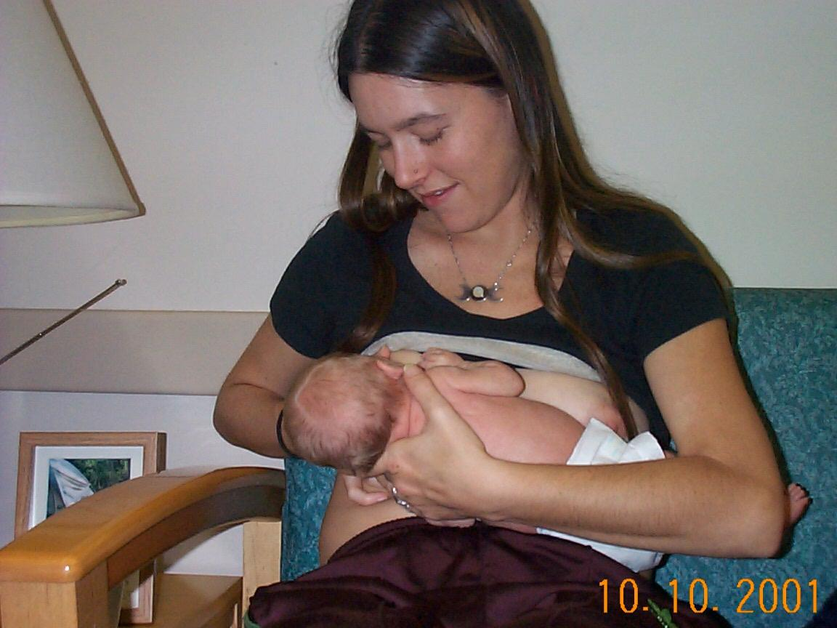
Cross-cradle Hold
Photo © Joan Meek, MD, FAAP

Slide 13
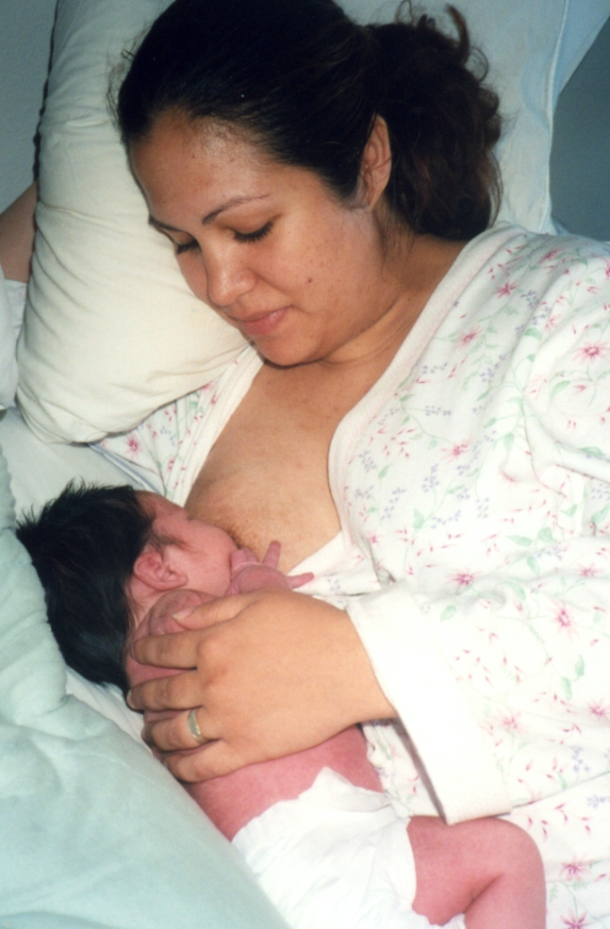
Side-lying Hold
Photo © Roni M. Chastain, RN

Slide 14
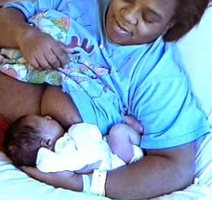
Football Hold
Photo © Lori Feldman-Winter, MD, MPH, FAAP

Slide 15

Laid Back Positioning
Mother is semi-reclined in a supported position
Babies lie on top of mother with head near the breast
Most babies then self attach- similar to breast crawl after birth
Notes:
mothers neither sit up right nor do they lie on their sides or flat on their back. Instead, they are in comfortable semi-reclined positions where every part of their body is supported especially their shoulders and neck. Then they lie their babies on top of their bodies so that babies head is somewhere near the breast. In other words mothers make the breast available. Babies lie prone or on their tummies but their bodies are not flat but tilted up. most mothers don’t attach the baby to the breast so there is no step-by-step fixed system to learn. Most babies self attach. Similar to the breast crawl babies do after birth while skin to skin.

Slide 16
Breast Crawl
https://www.ccbirthcenter.com/unicef-breastfeeding-crawl-video/
This link leads to a video by UNICEF showing the breast crawl by a newborn immediately after delivery.
This early initiation of breastfeeding can be accomplished by placing the newborn skin to skin with the mother immediately after birth.

Slide 17
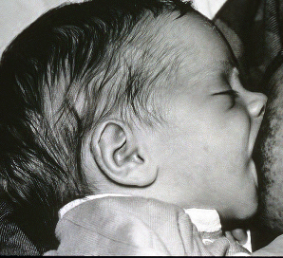
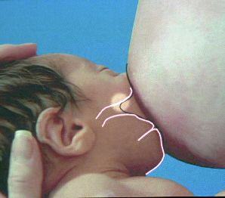
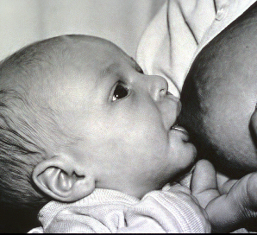
Proper Latch
CORRECT
INCORRECT
Nipple protected by positioning far back in infant’s mouth
Breast tissue inferior to nipple exposed to massaging action of tongue and lower jaw.
Photos © Jane Morton, MD, FAAP
Notes:
When the infant is latched correctly, the mother will feel a gentle tugging with the wave-like movements of the infants tongue and jaw, but should feel no pain
Suckling should be fast at first as the let-down reflex is initiated, but once the milk is ejected the suckling will slow into a rhythmic pattern with noted audible swallowing (if the room is quiet)
Upon completion of nursing, the mother can release the suction by inserting a clean finger into the corner of the infant’s mouth. This will decrease the risk of trauma to the nipple and breast tissue

Slide 18
How to help a mother to position and attach her baby
• Help the mother to get into a comfortable and relaxed position, sitting or lying down.
• The helper should sit in a comfortable, convenient position.
• Explain to the mother how to hold her baby, according to the four key points:
— with the head and body straight
— facing the breast, and starting with his/her nose opposite the nipple
— with his/her body close to her body (chest to chest)
— supporting the whole body.
• Show her how to support her breast:
— with her fingers flat against her chest wall under her breast
— with her thumb above the breast
— her fingers should not be on the areola or near the nipple, because this can interfere with attachment
• Explain or show the mother how to help her baby to attach by:
— touching the baby’s lips with her nipple
— waiting until the baby’s mouth is open wide
— moving the baby quickly onto her breast
— aiming her nipple up towards the roof of the baby’s mouth
— aiming his/her lower lip behind her nipple, so his/her chin touches the breast.
• Notice how the baby responds and ask her how the suckling feels.
• Look for signs of correct attachment. The four signs of good attachment are:
— more of the areola is visible above the baby’s top lip than below the lower lip
— the baby’s mouth is wide open
— the baby’s lower lip is curled outwards (lips flanged)
— the baby’s chin is touching or almost touching the breast.
• If attachment is not good, or if the mother is uncomfortable, ask her to try again.
• Show her how to take the baby off the breast by slipping her little finger into the baby’s mouth to release the suction

Slide 19
LATCH Score
L= Latch
  0= Too sleepy or reluctant, No latch achieved
  1= Repeated attempts, Hold nipple in mouth, Stimulate to suck
  2= Grasps breast, Tongue down, Lips flanged, Rhythmic sucking
A= Audible swallowing
  0= None
  1= A few with stimulation
  2= Spontaneous and intermittent <24h old, Spontaneous and frequent >24h old
T= Type of nipple
  0= Inverted, 1= Flat, 2= Everted (after stimulation)
C= Comfort (Breast/Nipple)
  0= Engorged, Cracked, Bleeding, large blisters or bruises, Severe discomfort
  1= Reddened, small blisters or bruises, Mild/moderate discomfort
  2= Soft, nontender
H= Hold (Positioning)
  0= Full assist (staff hold infant at breast)
  1= Minimal assist (ie elevate head of bed; place pillows for support), Teach one side, mother does other, Staff holds and then mother takes over
  2= No assist from staff, Mother able to position and hold infant
Notes:
LATCH SCORE: In hospital practice often scores recorded based on mother’s report instead of observation
L = Latch
0 = Too sleepy or reluctant, No latch achieved,1 = Repeated attempts, Hold nipple in mouth, Stimulate to suck
2 = Grasps breast, Tongue down, Lips Flanged, Rhythmic sucking
A = Audible swallowing
0 = None, 1 = A few with stimulation, 2 = Spontaneous and intermittent <24 hrs. old, Spontaneous and frequent >24 hrs. old
Type of nipple
0 = Inverted, 1 = Flat, 2 = Everted (after stimulation)
Comfort (Breast/Nipple)
0 = Engorged, Cracked, bleeding, large blisters or bruises, Severe discomfort , 1 = Filling Reddened/small blisters or bruises, Mild/moderate discomfort, 2 = Soft, Non-tender
H = Hold (Positioning)
0 = Full assist (staff hold infant at breast), 1= Minimal assist (i.e. elevate head of bed; place pillows for support), Teach one side, mother does other, Staff holds and then mother takes over, 2 = No assist from staff, Mother able to position & hold infant
Kumar SP, Mooney R, Wieser LJ, Havstad S . The LATCH scoring system and prediction of breastfeeding duration.
J Hum Lact. 2006 Nov;22(4):391-7.

Slide 20
More on Positioning and Latch
Watch Breastfeeding Management, Educational Tools for Physicians and Other Professionals by Jane Morton, MD, FAAP, for a live demonstration of how to observe and assess breastfeeding.
http://newborns.stanford.edu/Breastfeeding/FifteenMinuteHelper.html

Slide 21
Breastfeeding Problems

Slide 22
Sore Nipples
Myth- “Breastfeeding Hurts”
  Transient tenderness and sensitivity should subside within a few days if positioning and attachment are corrected
Poor positioning and improper latch are the most common causes of sore nipples
Other causes include poorly graspable nipples, infant facial abnormalities, or loss of moisture barrier
Pain may also be caused by yeast infection or mastitis
If caused by improper latch, baby may not be
effectively emptying breast, leading to accumulation
of Feedback Inhibitor of Lactation (FIL) and decreased milk supply
Nipple pain can inhibit let-down reflex
Not a result of feeding for too long
Notes:
Nipples can become bruised, chapped, and sore from repeated gum and tongue trauma from 1-poor positioning and latch from mother’s technique, 2-poorly graspable nipples (from engorgement, maternal flat or inverted nipples), 3-infant facial features that impede latch (cleft lip and palate, retrognathia [resulting in gum compression], or ankyloglossia [resulting in tongue friction]), 4-constant wet and dry plus friction results in chapped nipples due to loss of moisture barrier, 5-creased nipple can develop from incorrect latch with compression of nipple against hard palate.
• Improper latch may be secondary to “tongue-tie” (ankyloglossia), which along with mastitis and yeast infections are discussed in the Management of Common Breastfeeding Problems presentation.

Slide 23
Treatment of Sore Nipples
Ensure infant is well-positioned and latching on correctly — this may be all that is needed
Apply breast milk to nipple and areola after feeding, allow to air dry, then apply medical-grade lanolin
Use only water to clean breasts
May use acetaminophen or ibuprofen for pain management
If nipples are still sore, cracked, or bleeding, have mother begin breastfeeding on less affected side then switch to more affected side after let-down
May use a nipple shield during feedings and/or a breast cup or shell between feedings
Assess for ankyloglossia (tongue-tie)
Notes:
May need to support and shape breast throughout the feed to maintain correct latch; support infant’s head and shoulders to stabilize the neck and jaw muscles; feed infant in semi-upright position so gravity aids in jaw extension to minimize gumming and overbite
Fix tongue tie if present
May need to pump or hand express for 48 hours if pain still not relieved.

Slide 24
Ankyloglossia
Presents as ineffective latch or nipple pain
Lactation specialist consult if possible
Assessment by Hazelbaker Tool
Significant ankyloglossia when:
  Appearance score < 8 and Function score < 11
Attention to changing position on breast
Care of mother’s nipples to prevent injuries
Notes:
24
Hazelbaker tool has Appearance items to assess and Functional items (see next notes page)
Appearance items
Appearance of tongue
2: Round or square
1: Slight cleft in tip apparent
0: Heart- or V-shaped
Elasticity of frenulum
2: Very elastic
1: Moderately elastic
0: Little or no elasticity
Length of lingual frenulum when tongue lifted
2: > 1 cm
1: 1 cm
0: <1 cm
Attachment of lingual frenulum to tongue
2: Posterior to tip
1: At tip
0: Notched tip
Attachment of lingual frenulum to inferior alveolar ridge
2: Attached to floor of mouth or well below ridge
1: Attached just below ridge
0: Attached at ridge

Slide 25
Hazelbaker assessment tool for lingual frenulum function*
Appearance Items
Function Items
Appearance of tongue when lifted
  2: Round or square
  1: Slight cleft in tip apparent
  0: Heart- or V-shaped
Elasticity of frenulum
  2: Very elastic
  1: Moderately elastic
  0: Little or no elasticity mid-mouth only with jaw closure
Length of lingual frenulum when tongue lifted
  2: > 1 cm 1: 1 cm 0: <1 cm
  Attachment of lingual frenulum to tongue
    2: Posterior to tip 1: At tip 0: Notched tip
Attachment of lingual frenulum to inferior
  2: Entire edge, firm cup
  1: Side edges only, moderate cup
  0: Poor or no cup
Peristalsis
  2: Complete, anterior to posterior
  1: Partial, originating posterior to tip
  0: None or reverse motion
Snapback
  2: None
  1: Periodic
  0: Frequent or with each suck
Lateralization
  2: Complete
  1: Body of tongue but not tongue tip
  0: None
  Lift of tongue
    2: Tip to mid-mouth
    1: Only edges to mid-mouth
    0: Tip stays at lower alveolar ridge or rises to
Extension of tongue
  2: Tip over lower lip
  1: Tip over lower gum only
  0: Neither of the above, or anterior or mid-tongue humps
Spread of anterior tongue
  2: Complete
  1: Moderate or partial
  0: Little or none
Cupping alveolar ridge
  2: Attached to floor of mouth or well below ridge
  1: Attached just below ridge
  0: Attached at ridge
*The infant’s tongue is assessed using the 5 appearance items and the 7 function items. Significant ankyloglossia is diagnosed when the appearance score total is 8 or less and/or the function score total is 11 or less. Adapted with permission from Hazelbaker AK: The assessment tool for lingual frenulum function (ATLFF): Use in a lactation consultant private practice Masters thesis, Pacific OaksCollege, 1993.
Notes:
*The infant’s tongue is assessed using the 5 appearance items and the 7 function items.
Significant ankyloglossia is diagnosed when the appearance score total is 8 or less and/or the function score total is 11 or less. (2;3)
Adapted with permission from Hazelbaker AK: The assessment tool for lingual frenulum function (ATLFF): Use in a lactation consultant private practice Masters thesis, Pacific OaksCollege, 1993.

Slide 26
Engorgement
A warm shower or warm moist packs to the breasts may help the mother relax and enhance milk flow.
Gentle massage, hand expression or minimal use of a breast pump (hand or electric) are often used to soften the areola around the nipple to facilitate attachment. Some lactation specialists recommend using finger pressure to minimize the edematous areolar swelling around the nipple. This is known as areolar compression or reverse pressure softening.
More frequent and effective feedings (every 2-3 hours or more frequently if the baby is willing).
If baby will not nurse, begin frequent and effective emptying of breasts by hand or breast pump until engorgement is resolved.
If available, cold packs can be applied after feeding to help relieve congestion, and pain. Evaporation from the moist cloths adds to the cooling effect.
Anti-inflammatory drugs may also be useful.

Slide 27
Obstructed Lactiferous Duct
Examine the breast and observe a feed.
Have the mother gently massage the breast over the lump and start feeding from the affected breast first.
Change the position of the baby at each feeding to encourage more complete emptying of the ducts and increase the chance of removing the obstruction.
Apply warm, moist compresses to the affected area.
Advise the mother to continue to feed frequently, every 2-3 hours, until the lump is resolved. A longer sleep pattern may contribute to the development of the obstructed duct. The breasts will adjust to minor changes in frequency.
Note the appearance of the breasts. Are there marks on the skin that would suggest the bra is too tight? Suggest she remove the underwire in her bra if it appears to be a mechanical obstruction.
If the lump does not resolve after a few days of above treatment, she should return for reassessment of the situation because an unresolved blocked duct may lead to mastitis. Additionally, if the lump does not resolve or recurs, consider referral to rule out other causes such as tumors.

Slide 28
Mastitis
Continue frequent breastfeeding, or milk expression, at least every 2 ½ hours.
Rest as much as possible for 24 hours and have a relative or friend help with meals and household activities. Emphasize that rest is an important part of the treatment.
Antibiotics for 10 to 14 days and an analgesic as needed. (Recent reports suggest that if milk is removed effectively, antibiotics may not be needed.)
Evaluate position and attachment as a contributing factor to the cracked nipples; manage as indicated.
If her condition has not improved after 48 hours, she should contact her doctor.

Slide 29
Late Preterm Infant
34 0/7 to 36 6/7 weeks gestation
Frequently has trouble getting started with breastfeeding
Often considered more capable than they are
Often sleepy, fatigue easily and have difficulty with attachment and coordination of suck-swallow-breathing
At risk for hypothermia, hypoglycemia, hyperbilirubinemia, dehydration, or excessive weight loss
Also frequently separated from their mothers
Mothers of late preterm infants
  Often have multiple births and/or a medical condition such as diabetes or pregnancy induced hypertension with a subsequent pitocin induced delivery or c-section
  Skilled lactation support is indicated for both mother and baby. Such support needs to be ongoing not only while they are in hospital but after discharge.

Slide 30
Candidiasis
Maternal nipple and areola
  Symptoms
    Red, dry breasts
    Shiny, pink, or depigmented areola
    Itchy, burning breasts throughout and after a feed
    Radiating pain from breast to back

Slide 31
Candidiasis
Maternal nipple and areola
  Treatment
    Continue breastfeeding
    Evaluate and treat attachment problems
    Ibuprofen for pain
    Use disposable or clean, dry nursing pads
    Wash bras and night clothes in dilute bleach or sun dry
    Air dry breasts as much as possible
    All pump parts touching milk or breast should be washed and boiled daily
    Eliminate alcohol and minimize sugar in the diet
    Add acidophilus in the form of yogurt, pills or acidophilus milk to diet to assist normal colonizing of bacterial flora
    Medications
      Ketaconazole (Nizoral)
      Fluconazole (Diflucan) – but is not FDA approved
      Gentian violet (on mother’s nipples and babies’ mouth)

Slide 32
ABM Protocol:
Hypoglycemia
Early and exclusive breastfeeding meets the nutritional and metabolic needs of healthy, term newborn infants. The small physiologic volumes of colostrum are sufficient to meet the infant's metabolic demands.
ABM Clinical Protocol #1: Guidelines for Glucose Monitoring and Treatment of Hypoglycemia in Term and Late Preterm Neonates, Revised 2021
https://www.bfmed.org/assets/DOCUMENTS/PROTOCOLS/Protocol%20%231.pdf

Slide 33
Hypoglycemia
Transient hypoglycemia is normal in immediate newborn period in term infants
  Nadir of 20-25mg/dl occurs 1 to 1.5 hours after birth
  Spontaneously resolves by 3 hours even without po intake
  Glucose continues to rise to 43-90 mg/dl by 12-24 hours of life reaching adult levels by day of life 4
  No evidence that treating transient, asymptomatic hypoglycemia provides any benefit
Hypoglycemia may develop with prolonged intervals (>8 hours) between feeds
  Newborns have a marked ketogenic response
    Breastfed infants have higher levels of ketone bodies than do formula fed infants
  Neonatal brain has enhanced capacity to use ketone bodies as fuel thereby protecting neurologic function
Notes:
Outcome is different in symptomatic newborns- 12% increase in neurologic abn and a 50% increase in neuro abn with szs

Slide 34
Effect of Hypoglycemia
No long term effect on asymptomatic infants
  Studies (1-4 year follow up) have not shown an effect of treatment on short- or long-term neurologic outcomes compared with no treatment
Effect on symptomatic infants
  12% increase in neurologic abnormalities
  50% increase in neurologic abnormalities in infants with seizures due to hypoglycemia
  White matter changes have been demonstrated on MRI in neonatal period
Notes:
Animal studies and human postmortem studies suggest that severe prolonged hypoglycemia gives rise to distinct patterns of brain injury, with a propensity for occipital and parietal cortex and subcortical white matter (WM) involvement.
Early MRI findings were more instructive than severity or duration of hypoglycemia in predicting neurodevelopmental outcomes. PEDIATRICS Vol. 122 No. 1 July 2008, pp. 65-74 (doi:10.1542/peds.2007-2822)

Slide 35
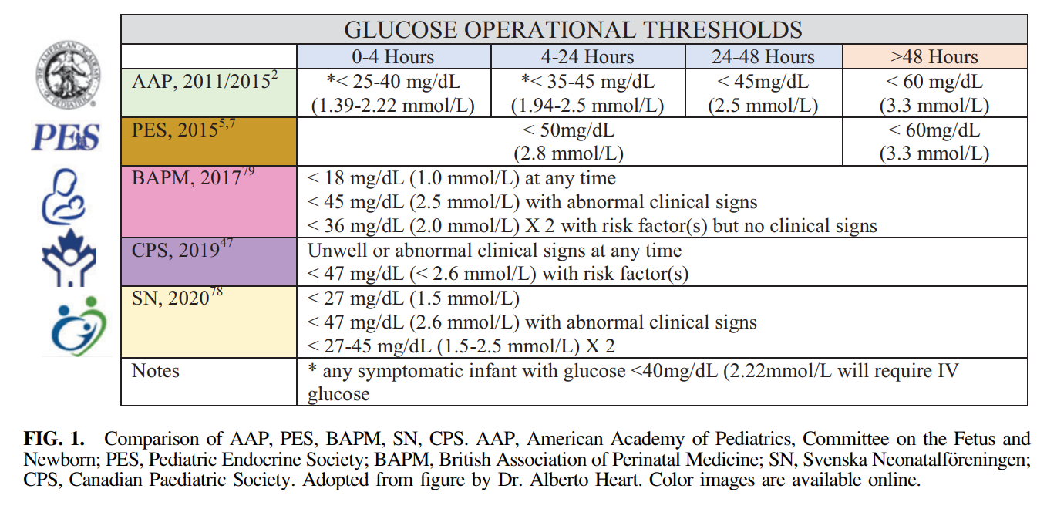
Definition of Hypoglycemia
Definition is controversial due to lack of correlation between plasma glucose, symptoms, and long term sequelae
AAP uses the numbers below based on infant age
Notes:
Plasma or serum glucoses are 10%-15% higher than in whole blood.

Slide 36
Routine Monitoring for Hypoglycemia
Routine monitoring is NOT recommended for healthy, term newborns
Routine monitoring is recommended for at risk infants who fall into 2 categories
  Neonates with excess utilization of glucose, includes hyperinsulinemic states
  Neonates with inadequate production of substrate delivery

Slide 37
Conditions with High Risk of Hypoglycemia
  Maternal conditions
    Pre-existing or gestational diabetes, or abnormal result of glucose tolerance test, especially if poorly controlled
    Pre-eclampsia and pregnancy induced, or essential hypertension
    Previous macrocosmic infants (as a proxy for undiagnosed diabetes in pregnancy)
    Substance abuse
    Treatment with beta-agonist tocolytics
    Treatment with oral hypoglycemic agents
    Late antepartum or intrapartum administration of IV glucose

Slide 38
Conditions with High Risk of Hypoglycemia: Neonatal Conditions
  Intrauterine growth restriction or marked wasting
  Low birth weight (<2,500 g)
  Small for gestational age; <10th percentile for weight
  Babies with clinically evident wasting of fat and muscle bulk LGA; >90th percentile for weight & macrosomic appearance
  Discordant twin; weight 10% < larger twin
  Infants of poorly controlled diabetic mothers
  Prematurity (<35 weeks or late preterm infants with clinical signs or extremely poor feeding)
  Perinatal stress; severe acidosis or hypoxia–ischemia
  Cold stress
  Polycythemia (venous hematocrit >70%)/hyperviscosity
  Erythroblastosis fetalis
  Beckwith–Wiedemann syndrome
  Microphallus or midline defect (indicating an underlying endocrine condition)
  Suspected infection
  Respiratory distress
  Known or suspected inborn errors of metabolism or endocrine disorders
  Any infant admitted to the neonatal intensive care unit
  Infants displaying signs associated with hypoglycemia

Slide 39
Clinical Manifestations of Possible Hypoglycemia
Neurogenic/adrenergic (sympathetic nervous system activation)
  Irritability
  Tremors, jitteriness
  Tachypnea
  Sweating
  Pallor, vasomotor instability
  Hypothermia; temperature instability
  Tachycardia
  Exaggerated Moro reflex
  High-pitched cry
  Excessive hunger signs
  Vomiting
  Poor suck or refusal to feed
Neuroglycopenic (brain dysfunction due to inadequate glucose)
  Lethargy, listlessness, limpness, hypotonia
  Seizures or myoclonic jerks
  Coma
  Apnea or irregular breathing
  Cyanosis
Notes:
Even in the presence of an arbitrary low glucose level, the physician must assess the general status of the infant by observation and physical examination to rule out other disease entities and processes that may need additional laboratory evaluation and treatment.
A diagnosis of hypoglycemia also requires that symptoms abate after normoglycemia is restored. Transient, single, brief periods of hypoglycemia are unlikely to cause permanent neurologic damage.

Slide 40
Timing of Screening for Hypoglycemia
Onset of symptoms
Within 60 minutes for infants with suspected hyperinsulinemia (e.g. poorly controlled maternal diabetes or known genetic hyperinsulinemia)
Before the 2nd feed, or 2-4 hours, after birth in other at risk groups (ie avoid physiologic nadir that could result in overtreatment)
Monitoring should continue until normal, preprandial levels are consistently obtained. (3 satisfactory measurements)
Confirm results of nonenzymatic glucometers with formal laboratory testing.
Notes:
Causes of neonatal hyperinsulinemia
Infant of a mother with diabetes
Infant who is SGA
Perinatal stress/asphyxia
Erythroblastosis fetalis
Sepsis
Beckwith-Wiedemann syndrome
Drug-induced hyperinsulinismSurreptitious insulin administration
Oral hypoglycemic ingestion
Blood transfusion
Umbilical artery catheter placement

Slide 41
Management of Hypoglycemia
Feeding recommendations:
  Routine supplementation of healthy, term infants with water, glucose water, or formula is unnecessary and may interfere with establishing normal breastfeeding and normal metabolic compensatory mechanisms.
  Initiation and establishment of breastfeeding is facilitated by skin-to-skin contact of mother and infant. Such practices will maintain normal infant body temperature and reduce energy expenditure (thus enabling maintenance of normal blood glucose) while stimulating suckling and milk production.

Slide 42
Management of Hypoglycemia
Feeding recommendations:
  Healthy term infants should initiate breastfeeding within 30 to 60 minutes of life and continue on demand, recognizing that crying is a very late sign of hunger. Early breastfeeding is not precluded just because the infant meets the criteria for glucose monitoring.
  Feedings should be frequent, 10 to 12 times per 24 hours in the first few days after birth

Slide 43
Treatment of
Asymptomatic Hypoglycemia
Asymptomatic infant
  Feedings should be frequent, 10 to 12 times per 24 hours in the first few days after birth, or feed any available amount of colostrum, or 2-10ml/feed (1st 24h) and 5-15ml/feed (24-48h of life) of substitute nutrition (donor milk, artificial milk)
  Recheck blood glucose concentration before subsequent feedings until the value is acceptable (>45mg/dl) and stable.

Slide 44
Treatment of
Asymptomatic Hypoglycemia
Asymptomatic infant (continued)
  Buccal 40% dextrose gel is recommended at 0.5 mL/kg (200 mg/kg) in conjunction with a feeding plan (preferably breastfeeding) when the glucose is low or borderline, and the blood glucose is checked before the next feeding. A single repeat dose of buccal dextrose appears safe.
  If glucose remains low despite feedings, begin IV glucose therapy and adjust intravenous rate by blood glucose concentration.
  Breastfeeding may continue during IV glucose therapy when the infant is interested and will suckle. Wean IV glucose as serum glucose normalizes and feedings increase.

Slide 45
Treatment of
Asymptomatic Hypoglycemia
Asymptomatic infant (continued)
  If the neonate is unable to suck or feedings are not tolerated, avoid forced feedings (e.g., nasogastric tube) and begin intravenous (IV) therapy (see the following). Such an infant is not normal and requires a careful examination and evaluation in addition to more intensive therapy.
  Carefully document signs, physical examination, screening values, laboratory confirmation, treatment and changes in clinical condition (i.e., response to treatment).

Slide 46
Treatment of
Symptomatic Hypoglycemia
Symptomatic infants (glucose <20-25mg/dL)
  Initiate intravenous 10% glucose solution with a bolus of 1-2ml/kg and continuous IV at 5-8 mg/(kg/min).
  Do not rely on oral or intragastric feeding to correct extreme or symptomatic hypoglycemia. Such an infant is not normal and requires an immediate and careful examination and evaluation in addition to IV glucose therapy.

Slide 47
Treatment of
Symptomatic Hypoglycemia
Symptomatic infants (continued)
  The glucose concentration in symptomatic infants should be maintained > 45 mg/dL .
  Adjust intravenous rate by blood glucose concentration.
  Encourage frequent breastfeeding after the initiation of IV therapy.

Slide 48
Treatment of
Symptomatic Hypoglycemia
Symptomatic infants (continued)
  Monitor glucose concentrations before feedings as the IV is weaned, until values are stabilized off intravenous fluids.
  Carefully document physical examination, screening values, laboratory confirmation, treatment, and changes in clinical condition (i.e., response to treatment).
  Do not use glucose gel in infants with clinical signs unless there is a delay in establishing IV access.
  Infants with severe hypoglycemia with cerebral symptoms such as seizures, impaired consciousness, or circulatory collapse should receive MRI and long term follow up.

Slide 49
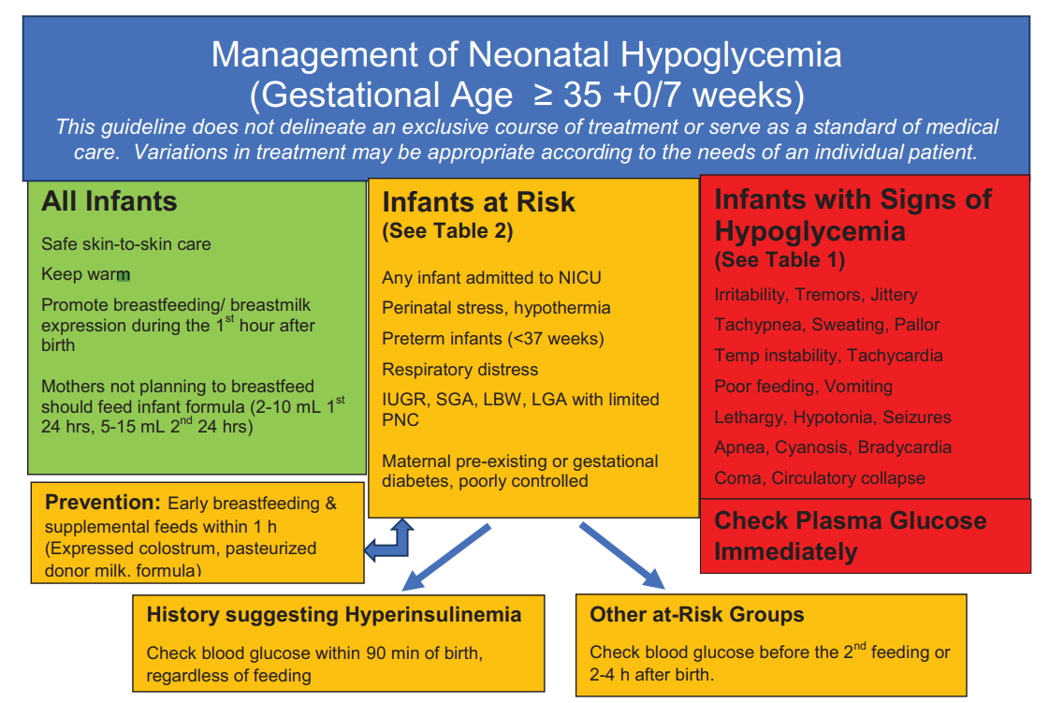
Management of Neonatal Hypoglycemia
(Gestational Age ≥ 35 +0/7 weeks)
This guideline does not delineate an exclusive course of treatment or serve as a standard of medical care. Variations in treatment may be appropriate according to the needs of an individual patient.

Slide 50
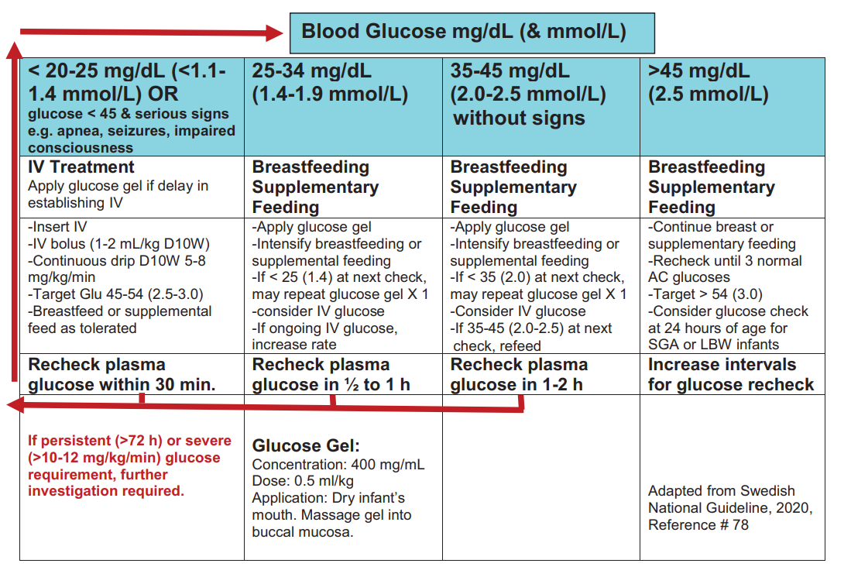
Management of Neonatal Hypoglycemia
(Gestational Age ≥ 35 +0/7 weeks)
This guideline does not delineate an exclusive course of treatment or serve as a standard of medical care. Variations in treatment may be appropriate according to the needs of an individual patient.​

Slide 51
Jaundice in Breastfeeding Infants
> 80% of newborns appear jaundiced in the first week of life
Bilirubin is an antioxidant and may protect infants from the relatively hyperoxygenic environment after birth
Breastfeeding jaundice
  More correctly described as suboptimal intake hyperbilirubinemia
  Increased with fewer than 8 feeds/day
    Low milk and low caloric intake result in decreased stool frequency and increased enterohepatic circulation of bilirubin
Continued breastfeeding is encouraged to ensure adequate caloric and nutrient intake to promote maturation of liver function and stimulate the passage of meconium and the excretion of bilirubin
Supplemental water or glucose water does not lower serum bilirubin and should not be given

Slide 52
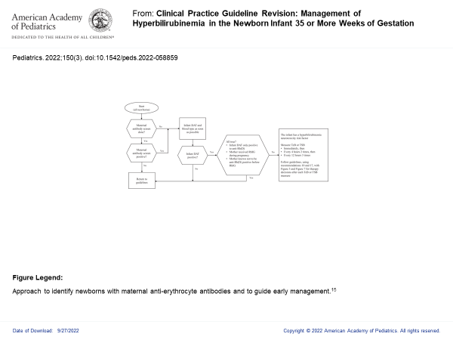
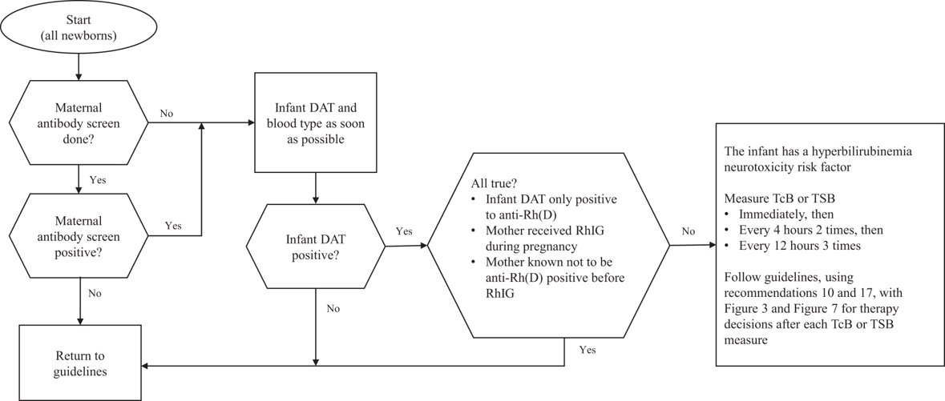

Slide 53
Risk Factors for Developing Significant Hyperbilirubinemia
• Lower gestational age (ie, risk increases with each additional week less than 40 wk)
• Jaundice in the first 24 h after birth
• Predischarge transcutaneous bilirubin (TcB) or total serum bilirubin (TSB) concentration close to the phototherapy threshold
• Hemolysis from any cause, if known or suspected based on a rapid rate of increase in the TSB or TcB of >0.3 mg/dL per hour in the first 24 h or >0.2 mg/dL per hour thereafter.
• Phototherapy before discharge
• Parent or sibling requiring phototherapy or exchange transfusion
• Family history or genetic ancestry suggestive of inherited red blood cell disorders, including glucose-6-phosphate dehydrogenase (G6PD) deficiency
• Exclusive breastfeeding with suboptimal intake
• Scalp hematoma or significant bruising
• Down syndrome
• Macrosomic infant of a diabetic mother
https://publications.aap.org/pediatrics/article/150/3/e2022058859/188726/Clinical-Practice-Guideline-Revision-Management-of?autologincheck=redirected?nfToken=00000000-0000-0000-0000-000000000000

Slide 54
Hyperbilirubinemia Neurotoxicity Risk Factors
• Gestational age <38 wk and this risk increases with the degree of prematurityª
• Albumin <3.0 g/dL
• Isoimmune hemolytic disease (ie, positive direct antiglobulin test), G6PD deficiency, or other hemolytic conditions
• Sepsis
• Significant clinical instability in the previous 24 h
a Gestational age is required to identify the phototherapy thresholds

Slide 55
Assessment of Jaundice
All infants should be visually assessed for jaundice every 12 hours from delivery to discharge with a bilirubin measurement for jaundice <24h after birth
Transcutaneous (TcB) or serum (TSB) bilirubin should be measured between 24 and 48 hours after birth
  TSB should be measured if TcB is within 3 mg/dl of phototherapy tx threshold or >15 mg/dl
Rapid rise of TcB or TSB (>0.3 mg/dl per hour in 1st 24 hours; >0.2 mg/dl per hour thereafter) suggests hemolysis, so check DAT if not yet done.
Delay discharge for infants who cannot have appropriate outpatient bilirubin follow up.
  Once bilirubin has spontaneously decreased over at least 6 hours, the risk of subsequent hyperbilirubinemia is low and further measurements are unnecessary without other worrisome signs.

Slide 56
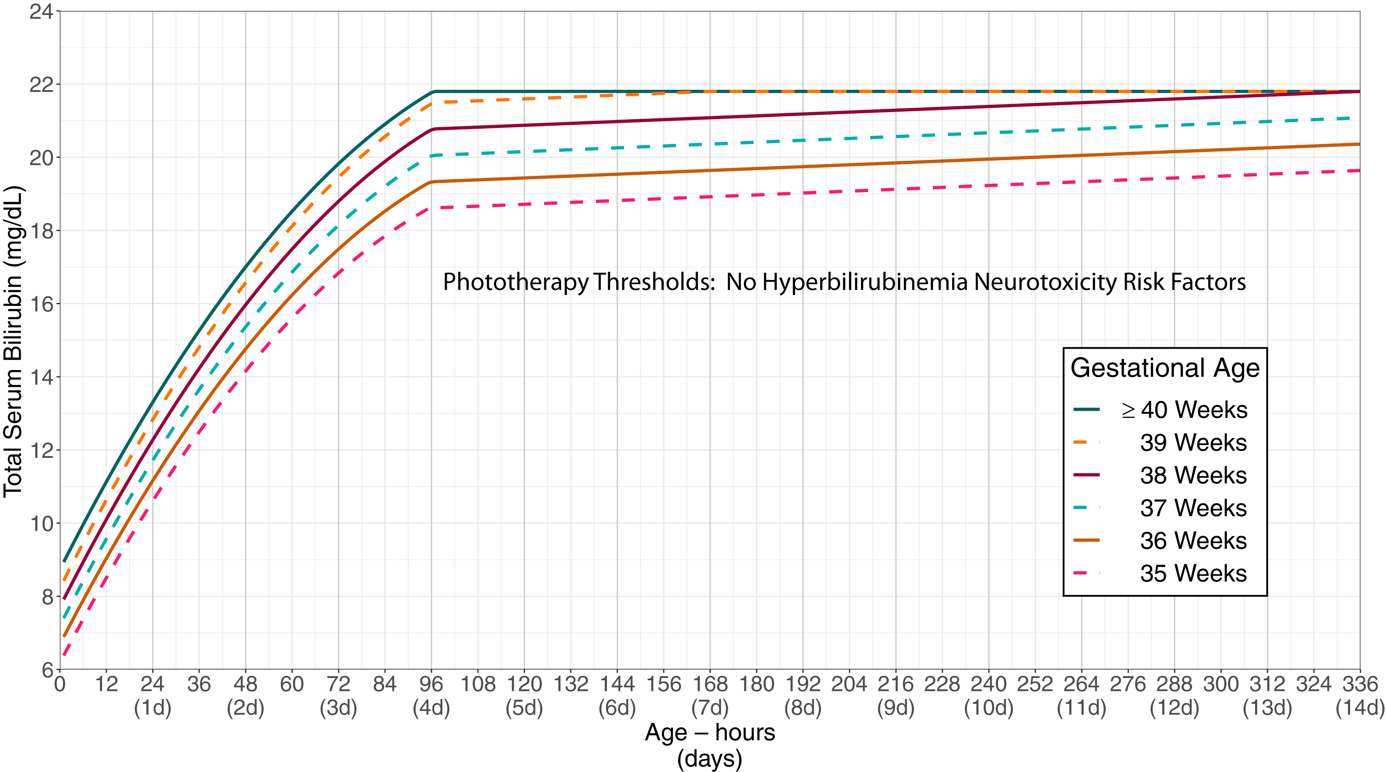
Phototherapy thresholds by gestational age and age in hours for infants with no recognized hyperbilirubinemia neurotoxicity risk factors other than gestational age.
These thresholds are based on expert opinion rather than strong evidence on when the potential benefits of phototherapy exceed its potential harms. Use total serum bilirubin concentrations; do not subtract direct-reacting or conjugated bilirubin from the total serum bilirubin. In rare cases of severe hyperbilirubinemia in which the direct-reacting or conjugated bilirubin exceeds 50% of the TSB, consult an expert. Note that infants <24 hours old with a TSB at or above the phototherapy threshold are likely to have a hemolytic process and should be evaluated for hemolytic disease as described in recommendation 14. Hyperbilirubinemia neurotoxicity risk factors include gestational age <38 weeks; albumin <3.0 g/dL; isoimmune hemolytic disease, glucose-6-phosphate dehydrogenase (G6PD) deficiency, or other hemolytic conditions; sepsis; or any significant clinical instability in the previous 24 hours.​
https://publications.aap.org/view-large/figure/10285209/PEDS_2022058859_f2.tif

Slide 57
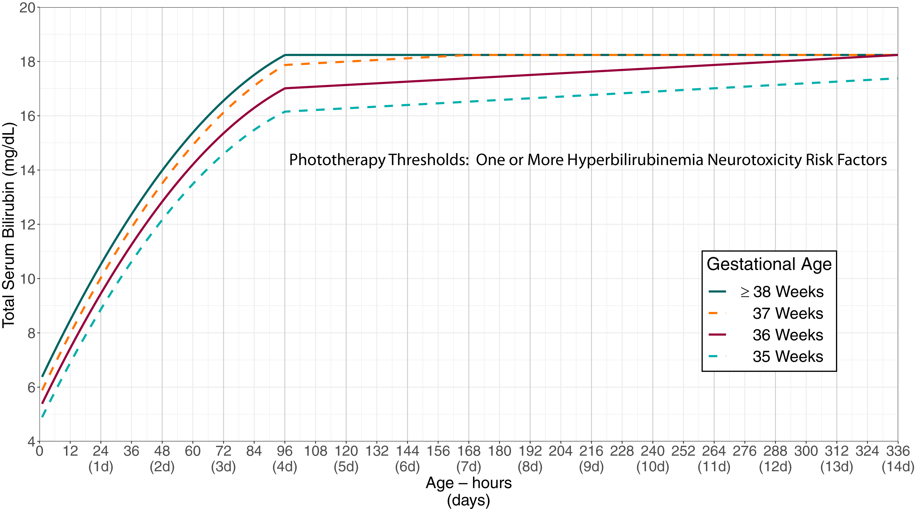
Phototherapy thresholds by gestational age and age in hours for infants with any recognized hyperbilirubinemia neurotoxicity risk factors other than gestational age
https://publications.aap.org/view-large/figure/10285210/PEDS_2022058859_f3.tif

Slide 58
Jaundice Treatment
Inpatient
Intensive phototherapy is recommended at the total serum bilirubin thresholds seen in the two previous slides
  Treatment is based on gestational age, hyperbilirubinemia neurotoxicity risk factors, and age of the infant in hours
  Thresholds are higher than in the 2004 guidelines due to evidence that bilirubin neurotoxicity does not occur until concentrations well above the 2004 levels
Intensive phototherapy
  Apply to as much of infant's surface area as possible
  Narrow-spectrum LED blue light with an irradiance of at least 30 µW/cm2 per nm at a wavelength around 475 nm
  Can quickly lower TSB and should shorten the duration of treatment
  Delivery methods are not standardized resulting in substantial variation in equipment
Although phototherapy increases insensible water loss to some degree, infants under phototherapy do not routinely require extra oral or intravenous fluids

Slide 59
Jaundice Treatment after Discharge
Discharged newborns who develop bilirubin above the phototherapy threshold may be treated with a home LED-based phototherapy device if:
  Gestational age ≥38 weeks
  ≥48 hours old
  Clinically well with adequate feeding
  No known hyperbilirubinemia neurotoxicity risk factors
  No previous phototherapy
  TSB concentration no more than 1 mg/dL above the phototherapy treatment threshold
  An LED-based phototherapy device will be available in the home without delay
  TSB can be measured daily

Slide 60
Monitoring Infants Receiving Phototherapy
Hospitalized
  TSB should be measured within 12 hours of starting phototherapy
  Frequency of TSB monitoring is guided by age of child, neurotoxicity risk factors, TSB concentration, and TSB trajectory
  TcB underestimates TSB in skin exposed to phototherapy
Discharged
  TSB should be measured daily
  Infants should be admitted if TSB increases or if TSB is ≥1 mg/dL above the phototherapy threshold
For infants requiring phototherapy, measure the hemoglobin concentration, hematocrit, or complete blood count to assess for the presence of anemia and to provide a baseline in case subsequent anemia develops.

Slide 61
Discontinuing Phototherapy
Discontinuing phototherapy
  Option when the TSB has decreased by at least 2 mg/dL below the hour-specific threshold at the initiation of phototherapy
  Longer period of phototherapy is an option if there are risk factors for rebound hyperbilirubinemia (eg, gestational age <38 weeks, age <48 hours at the start of phototherapy, hemolytic disease).
Goal is to minimize exposure to phototherapy and separation from mother while avoiding rebound in TSB
  Rebound = TSB at phototherapy threshold for the infant’s age within 72 to 96 hours of discontinuing phototherapy
  Increased risk for rebound
    younger postnatal age (ie, <48 hours) at the start of phototherapy, hemolytic disease, gestational age <38 weeks, and higher TSB at the time of phototherapy discontinuation in relationship to the phototherapy threshold

Slide 62
Follow-up after Phototherapy
Repeat bilirubin testing depends on risk of rebound hyperbilirubinemia
Measure TSB 6 to 12 hours after phototherapy discontinuation and a repeat bilirubin measured on the day after phototherapy discontinuation
  Infants who exceeded the phototherapy threshold during the birth hospitalization and
    (1) received phototherapy before 48 hours of age;
    (2) had a positive DAT; or
    (3) had known or suspected hemolytic disease
All other infants should have bilirubin measured the day after phototherapy discontinuation.

Slide 63
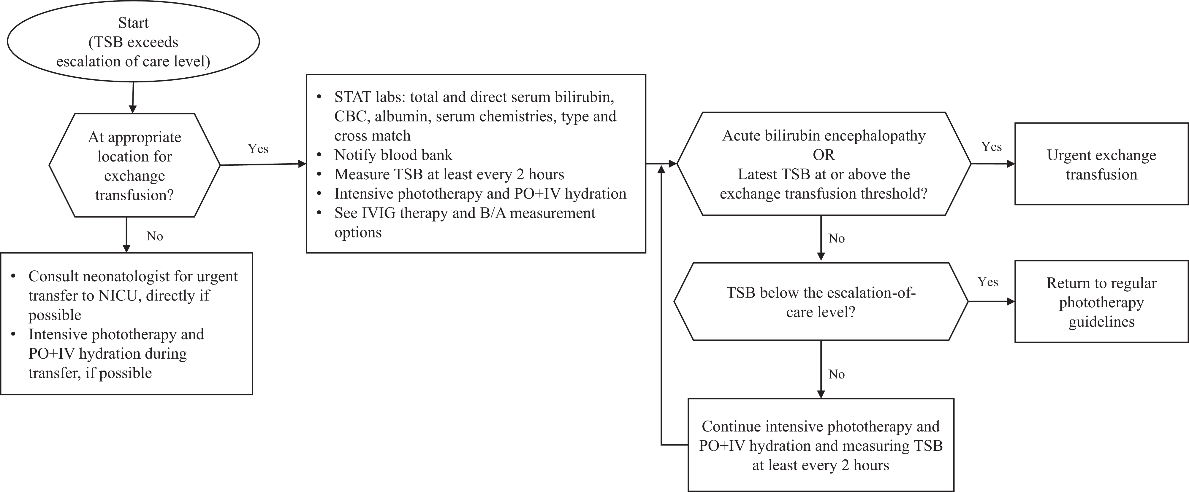
Approach to escalation of care:
The escalation-of-care threshold is 2 mg/dL below
the exchange transfusion threshold.
IVIG, intravenous immune globulin; B/A, bilirubin to albumin ratio.​
https://publications.aap.org/view-large/figure/10285239/PEDS_2022058859_f4.tif

Slide 64
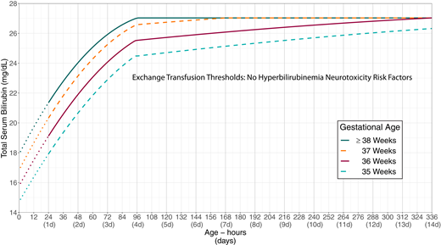
Exchange transfusion thresholds by gestational age for infants with no recognized hyperbilirubinemia neurotoxicity risk factors other than gestational age
https://publications.aap.org/view-large/figure/10285243/PEDS_2022058859_f5.tif

Slide 65
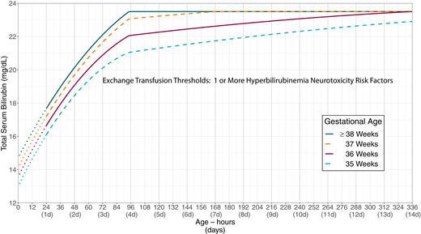
Exchange transfusion thresholds by gestational age for infants with any recognized hyperbilirubinemia neurotoxicity risk factors other than gestational age
https://publications.aap.org/view-large/figure/10285244/PEDS_2022058859_f6.tif​

Slide 66
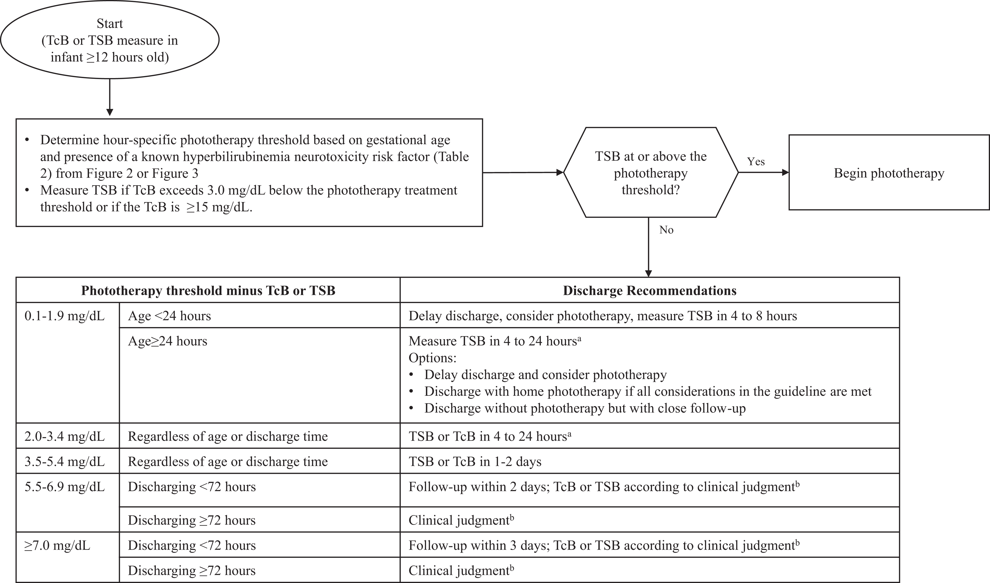
Discharge Follow-up for Infants
who have not Received Phototherapy
aUse clinical judgment and shared decision making to determine when to repeat the bilirubin measure within this 4 to 24 hour time window.​
bClinical judgment decisions should include physical examination, the presence of risk factors for the development of hyperbilirubinemia (Table 1) or hyperbilirubinemia neurotoxicity risk factors (Table 2), feeding adequacy, weight trajectory, and family support.​
https://publications.aap.org/view-large/figure/10285259/PEDS_2022058859_f7.tif

Slide 67
Breastmilk Jaundice or
Breastmilk Jaundice Syndrome
Prolonged levels of unconjugated hyperbilirubinemia
  May last up to 3 months
  Almost always nonpathologic and not associated with direct/conjugated hyperbilirubinemia
Visible jaundice for several weeks
As long as pathologic causes are excluded, and the infant is well, growing, and thriving, continue breastfeeding
Probably caused by factors in breast milk that block certain proteins in the liver that break down bilirubin so level can increase with increased breastmilk intake

Slide 68
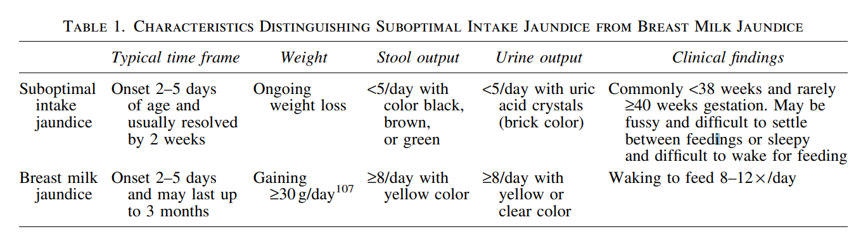
Suboptimal Intake v Breast milk Jaundice
https://abm.memberclicks.net/assets/DOCUMENTS/PROTOCOLS/22-jaundice-protocol-english.pdf

Slide 69
Thank you for completing Section 3 of Breastfeeding Education for Physicians. To obtain CME credit, please click on the link below, provide your information and complete the post-test
https://www.surveymonkey.com/s/BreastfeedingSection3

